Slide 1

Quantitative Field Ecology – More About T-Tests!

Slide 2

Review: Student’s T-Test
The t-test is a statistical method used to compare the means of one or more groups to a known value or each other.
It is particularly useful when sample sizes are small, and the population variance is unknown.
In biology, the t-test is applied to compare traits between species or treatment effects, such as measuring differences in growth rates or physiological responses.
Fun Fact: The t-test was developed by William Gosset under the pseudonym 'Student' in 1908 while working for Guinness brewery.
Notes:
You probably got the gist of this from our hypothesis testing lecture

Slide 3
Overview of T-Test Types
One-Sample T-Test:
Compares the mean of a single sample to a known value.
Independent Samples T-Test:
Compares the means of two independent groups (e.g., two species or treatment vs. control).
Paired Samples T-Test:
Compares means of two related groups (e.g., measurements from the same individuals before and after a treatment).
Notes:
Our activity was with the independent samples t-test (also called the… two sample t test! Theyre the same thing lol)

Slide 4
Assumptions of the T-Test
Normality: The data should be approximately normally distributed, especially for small samples.
Independence: Observations must be independent of each other, applicable for independent and one-sample t-tests.
Homogeneity of Variances: The variances of the groups being compared should be equal, specifically for the independent t-test.
Testing Assumptions: Methods like the Shapiro-Wilk test can be used for normality, and Levene’s test can test for equal variances.

Slide 5
Shapiro-Wilk Test
Evaluates the goodness of fit of a normal distribution to a set of data randomly sampled from a population.
Caution:
A small sample size might not yield enough power to reject the null hypothesis of normality, even when data are drawn from a population without a normal distribution.
With large enough samples, therefore, the sampling distribution of means behaves roughly as assumed by methods based on the t-distribution even when the data are not from a normally distributed population, provided that the violation of normality is not too drastic
Notes:
H0: The data are sampled from a population having a normal distribution.
HA: The data are sampled from a population not having a normal distribution.

Slide 6
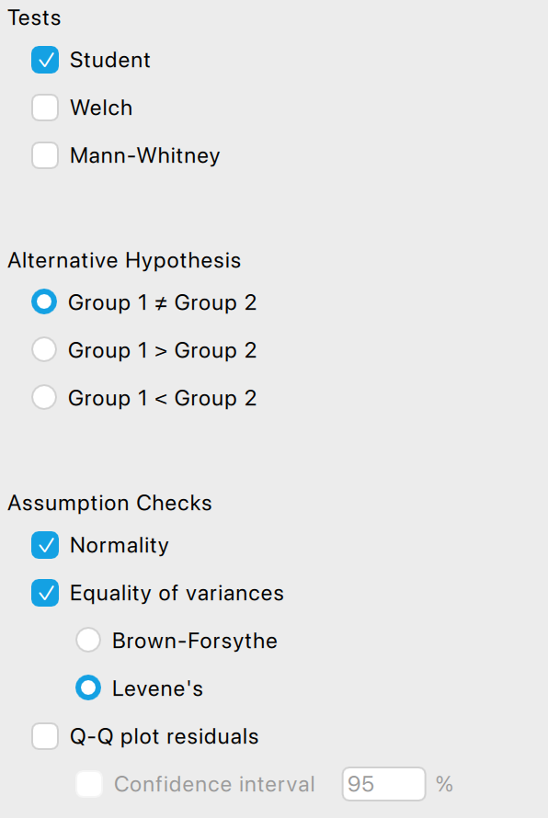
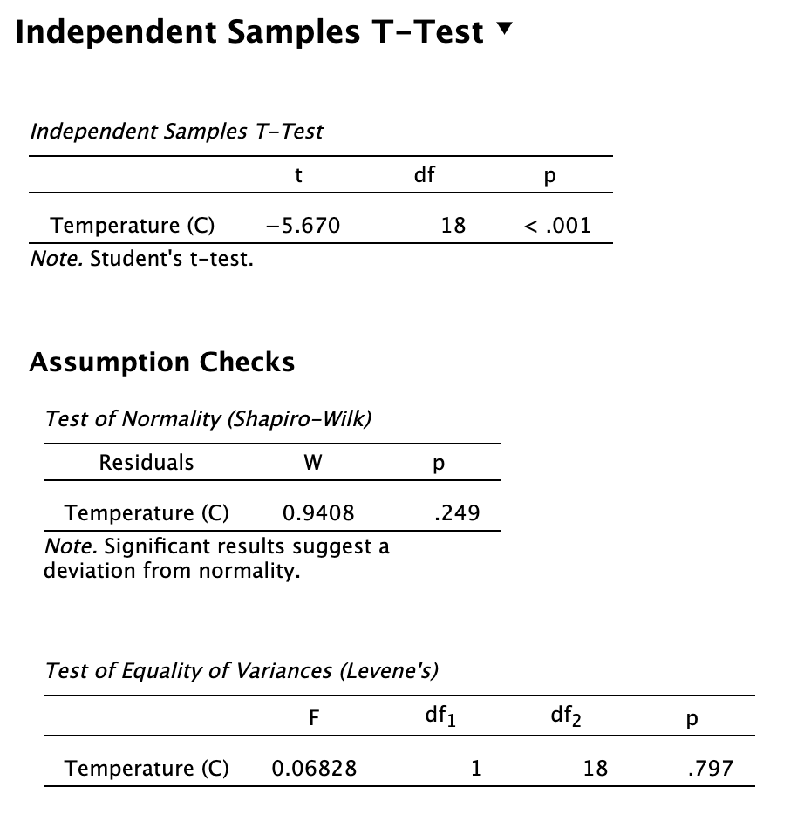
Notes:
If you’re using a statistics program, such as our friend JASP, then all you have to do is literally click a button.
ASK: Does it looks like there is a deviation from normality?
No, the p-value is not significant. I wouldn’t reject the null that the data are sampled from a population having a normal distribution.

Slide 7

What if it’s not normal?
If the data show strong departures from normality, such as outliers, or if the frequency distributions in different groups are markedly different, then it is best to adopt another option.

Slide 8
Data Transformations
The most common data transformation in biology is the log transformation. Typically, the data are converted by taking the natural log (ln) of each measurement.
If the data include zeros, then Y′=ln[ Y+1 ] can be tried instead.
Body measurements such as mass and length often show right-skewed frequency distributions that become more normally distributed after being log-transformed.
Log transformation is worth a try. Just be sure to check the distribution of the transformed data to determine whether it fits the assumptions of the desired method.
Notes:
If your data are proportions, you can use the arcsine transformation, and when your data are counts, you can use the square root transformation (take each observation, add 1/2 to it, and take the square root of all that).
After all that, you may have to use a non-parametric test instead! I’ll talk about those in a few minutes

Slide 9
Levene’s Test
Tests the null hypothesis that the variances of two or more groups are equal.
Assumes that the frequency distribution of measurements is roughly symmetrical within all groups.
Bonus: it can be applied to more than two groups; in fact, it can test the null hypothesis that multiple groups all have equal variances.
The formula is very intense so just use a statistical program to do it!

Slide 10
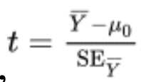
One-Sample T-Test: Concept and Formula
Use when comparing the mean of your sample to a known population mean.
Real-world example: Testing if the average leaf size in a population of trees differs from the national average.
Notes:
Your variable of interest, in this case the mean – difference between that and the known population mean, what you want to compare it to
Divided by the standard error (remember, the sample standard deviation divided by the square root of the sample size)
Gives us our calculated t value

Slide 11

One-Sample T-Test Example
Context
Measure the height of 15 frogs in a pond to see if their average height is different from 10 cm (the known average).
Calculate Mean
Use T-Test Formula
Apply the one-sample t-test formula: t = (X̄ - μ) / (s / √n), where X̄ = sample mean, μ = population mean, s = sample SD, n = sample size.
Interpret p-value
Calculate the sample mean and standard deviation of the frog heights by summing the heights and dividing by 15.
Compare the calculated t-value with the critical t-value (df = n - 1). If p < 0.05, reject the null hypothesis.
Notes:
Sample data: Heights of 15 frogs: 9.8, 10.1, 9.7, 10.3, 9.9, 10.0...
Sample mean and standard deviation.
Calculated t-value.
Conclusion based on p-value.

Slide 12
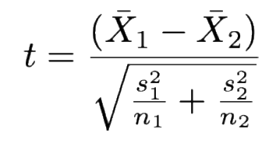
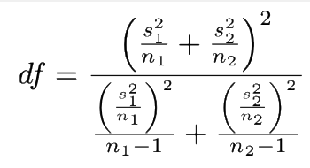

Independent Samples T-Test: Concept and Formula
Use when comparing means of two independent groups (e.g., comparing plant growth under two different treatments).
Degrees of freedom for this test is calculated using:
another way to write the denominator
If there’s no homogeneity of variance!
Notes:
Remember if there is homogeneity of variance, and the sample sizes are the same, etc., then use the degrees of freedom n1+n2 - 2

Slide 13


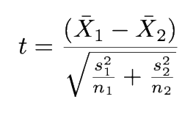
Independent Samples T-Test Example
Context
Comparing average leaf area of two plant species—birch & maple.
Calculate Means
Calculate means, standard deviations, and variances of each group.
Apply T-Test Formula
Use the formula, and calculate t-value.
Interpret Results
Interpret t-value & degrees of freedom. Compare p-value to 0.05. If p < 0.05, reject null hypothesis; leaf areas are significantly different.
Notes:
Group 1 (Birch): Leaf areas (cm²): 12, 14, 11, 13, 15
Group 2 (Maple): Leaf areas (cm²): 17, 19, 18, 16, 20
Means and variances calculated.
Calculated t-value.
Conclusion on significance.

Slide 14
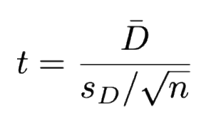
Paired Samples T-Test: Concept and Formula
Use when comparing the means of two related groups, such as pre- and post-treatment measurements of the same subjects.
The formula for the Paired Samples T-Test is:
Applications include studies measuring the effect of treatments, such as comparing plant heights before and after applying fertilizer.
Notes:
D is the mean difference between the two observations
Standard deviation is calculated based on the differences, and then sample size.
Denominator is also sample standard error

Slide 15

Paired Samples T-Test Example
Context
Measuring the height of plants before and after applying fertilizer.
Calculate Differences
Find the difference between pre-treatment and post-treatment heights for each plant.
Apply T-Test Formula
Use the formula.
Interpret Results
Interpret the t-value and p-value to determine if there is a significant difference in heights before and after treatment.
Notes:
Before Treatment: Heights (cm): 10, 12, 11, 13, 14
After Treatment: Heights (cm): 12, 13, 13, 15, 16
Differences: 2, 1, 2, 2, 2
Mean difference: 1.8
Standard deviation: Calculate based on differences.
If p < 0.05, reject the null hypothesis, suggesting that the fertilizer has a significant effect on plant height.
KEEP IN MIND – sample size n is the number of PAIRS not the number of measurements. Aka the number of difference calculations. If I measured the heights of 5 plants before and after adding fertilizer, I made 10 measurements, but I only have 5 pairs of measurements.

Slide 16

Choosing the Right T-Test
Are the groups related or independent?
  If related, use a Paired Samples T-Test. If independent, consider the next question.
Do you have a known population value or two groups to compare?
  If a known value, use a One-Sample T-Test; if two groups, proceed to the next step.
Do the variances seem equal between groups?
  If yes, use Independent Samples T-Test; if no, consider using a variant that accommodates unequal variances.

Slide 17

Interpreting T-Test Results
The t-value indicates how far the sample mean is from the population mean or the difference between group means.
Degrees of freedom is a function of sample size, used to adjust the t-distribution.
The p-value represents the probability that the observed difference is due to chance.
  For example, if p < 0.05, we reject the null hypothesis, suggesting that the group means are significantly different.

Slide 18
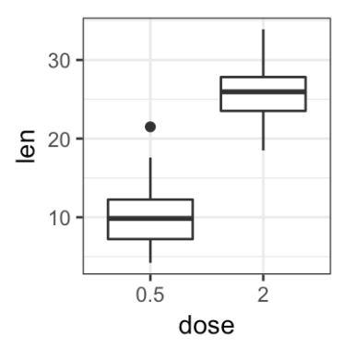
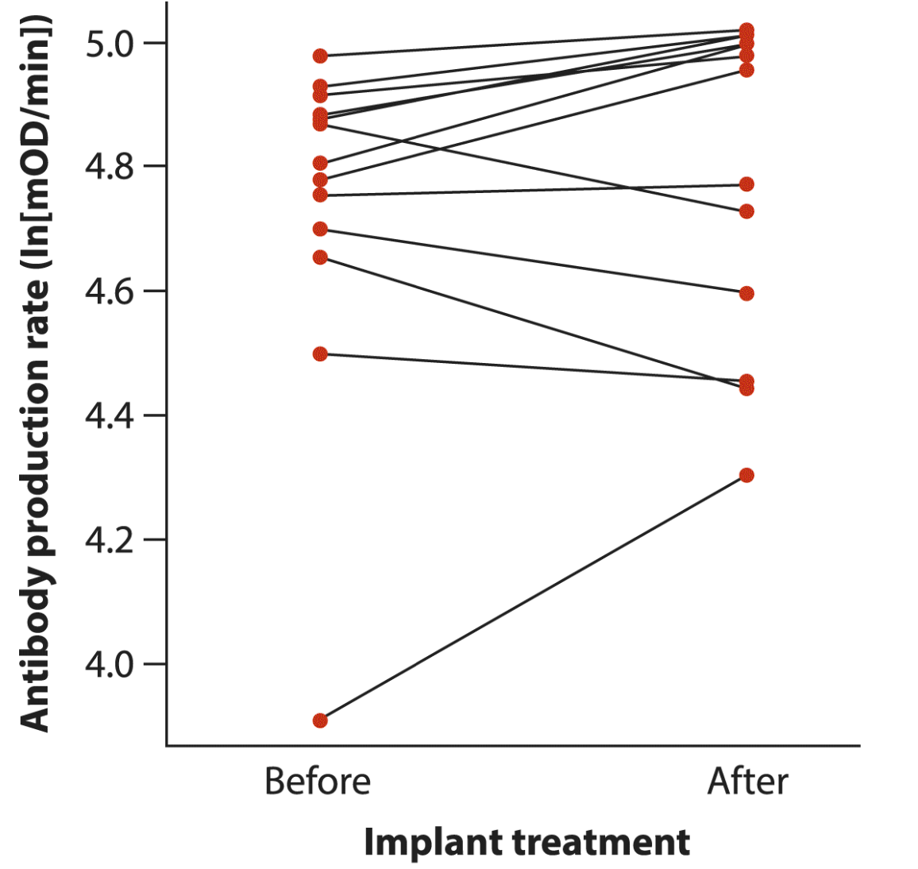
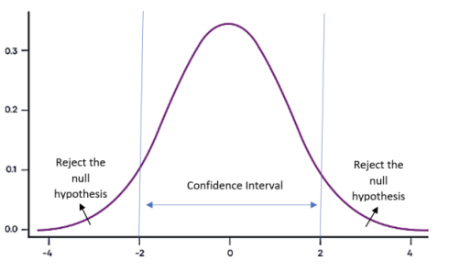
Visualizing T-Test Results
Box Plots
Line Plots
T-Distribution Curve
Box plots visually represent the distribution of data, highlighting medians, quartiles, and outliers, which help in comparing group distributions.
Line plots are effective for displaying changes in paired data over time or treatment, making it easier to see trends and differences between groups.
T-distribution curves illustrate the significance levels and critical regions, essential for understanding the context of t-test results and p-values.
Notes:
T-dist curve: larger differences give you a more unusual t-value, which in turn means there’s a lower probability of getting your results from random chance (rather than some sort of biological/ecological process taking place)

Slide 19
Common Mistakes and Misinterpretations
Assuming normality when data is skewed, which can lead to incorrect conclusions about the significance of results.
Misinterpreting p-values as the probability that the null hypothesis is true, rather than the probability of observing the data given that the null hypothesis is true.
Using a t-test for non-parametric data when another test (like the Mann-Whitney U test) might be more appropriate.

Slide 20
Sign Test and Wilcoxon Signed-Rank Test
The sign test compares the median of a sample to a constant specified in the null hypothesis. It makes no assumptions about the distribution of the measurement in the population.
Has low power compared with the one-sample or paired t-test because it discards most of the information in the data.
Sometimes, no other test is possible
The Wilcoxon signed-rank test is an improvement on the sign test for evaluating whether the median of a population is equal to a null-hypothesized constant.
Unfortunately, it assumes that the distribution of measurements in the population is symmetric around the median—in other words, that no skew is present.
Notes:
INSTEAD OF ONE SAMPLE OR PAIRED T TESTS!
Sign test is basically a binomial test (you can look up how to do it) and computer programs will carry out Wilcoxon test for you, it just usually won’t tell you about this limitation

Slide 21
Mann-Whitney U-Test
Tests whether the frequency distributions of two groups are the same. If the distributions of the two groups have the same shape, then the Mann–Whitney U-test compares the locations (medians or means) of the two groups.
Calculation is complicated because it requires ordering the data and assigning ranks to them – unrealistic to do by hand unless you have a small sample size.
You get a U value, and find a critical value (similar to your t-test) with an associated p-value, so if your u value is less than the critical value, your p value is not significant and you cannot reject the null!
Notes:
INSTEAD OF TWO SAMPLE/INDIVIDUAL t test
Statistics prpgrams will just be able to do the mann-whitney test and give you your p value.

Slide 22
Mann-Whitney U-Test: Considerations
The null hypothesis H₀ is that the distributions are the same. Rejecting H₀ therefore implies that the distributions are not the same. However, rejecting the null hypothesis does not necessarily imply that the two distributions have different locations (means or medians).
Very sensitive to differences between distributions in their shapes caused by unequal variances or different skews!
Should be used to test the null hypothesis that the distributions are the same, rather than testing the null hypothesis that the locations (means or medians) are the same.
Notes:
Nonparametric tests are typically less powerful than parametric tests.
There’s also permutation tests but I don’t super have time to talk about it here

Slide 23
Recap & Summary
One-sample t-test compares the mean of a sample to a known population mean.
Independent samples t-test compares the means of two independent groups.
Paired samples t-test compares the means of two related groups, such as pre- and post-treatment.

Slide 24
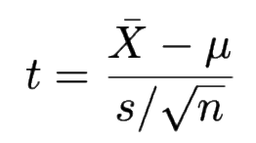

Recap & Summary
General formula for t-test:
Key concepts include t-value, which indicates how far the sample mean is from the population mean, and p-value, representing the probability that the observed difference is due to chance.
T-tests are fundamental tools for comparing means in biological research, but they must be applied with care!

